Slide 1


Research progress
MD Sifatul Islam

Slide 2



Table of contents
Hologram and Wave front Recording Plane
Multiple Wavefront Recoding Plane
Distributed Multiple Wavefront Recoding Plane ( OSK 2019 )
Future work

Slide 3
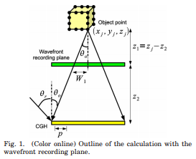
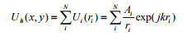
Wavefront recording plane (WRP)
Complex amplitude on a CGH plane as U_{h} ( x, y ) , the object is composed of N points, and the complex amplitude on the CGH created by the i-th point in distance r_{i} is U_{i} ( r_{i} ). The final complex amplitude U_{h} ( x, y ) is expressed by by equation (1)
(1)
1
2
WRP calculates CGH in 2 steps:
The light wave from 3D objects is recorded on a WRP.
Light wave from the WRP to CGH is diffracted calculation based on fast Fourier transform (FFT)
1. Tomoyoshi Shimobaba, Nobuyuki Masuda, and Tomoyoshi Ito, "Simple and fast calculation algorithm for computer-generated hologram with wavefront recording plane," Opt. Lett. 34, 3133-3135 (2009)

Slide 4
Conventional Wavefront Recording Plane (M-WRP)
N(z₁) = 2
N(z₁) = 2
N(z₂) = 1
N(z₂) = 1
N(z₃) = 3
WRP 1
N(z₃) = 3
Depth
Range 1
WRP 1
N(z₄) = 3
N(z₄) = 3
Depth
Range 1
N(z₆) = 1
N(z₆) = 1
N(z₇) = 1
N(z₇) = 1
WRP 2
Depth
Range 2
N(z₆) = 1
N(z₆) = 1
N(z₇) = 2
N(z₇) = 2
(a) Number of WRP =1
(b) Number of WRP = 2
**N(Z_{i}) = Number of object point in Z_{i} ^{th} layer
Fig 2 : Depth ranges in conventional M-WRP

Slide 5
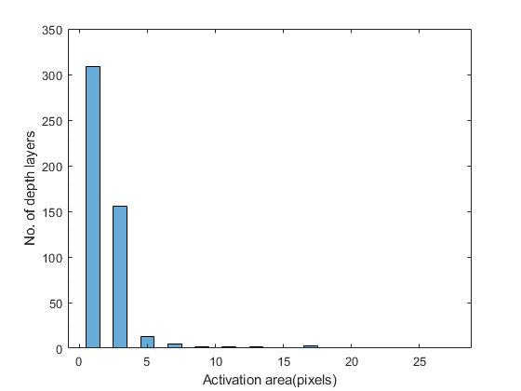
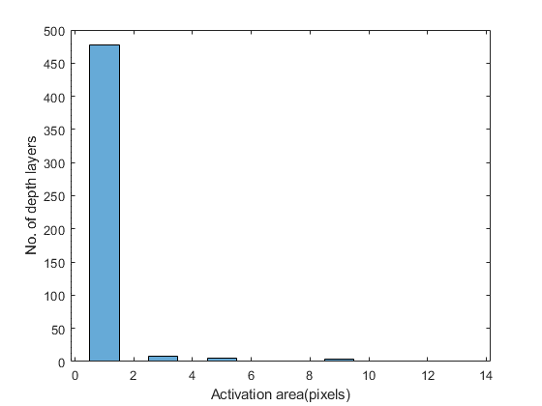
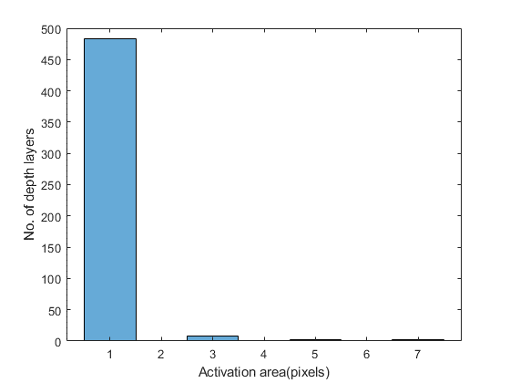
Conventional Wavefront Recording Plane (M-WRP)
Total number of WRP = 55
PSNR: 11.41
Total number of depth layers
= 55 WRP * 9 depth layers
Total number of WRP = 165
PSNR: 11.88
Total number of depth layers
= 165 WRP * 3 depth layers
Total number of WRP = 248
PSNR : 12.10
Total number of depth layers
= 247 WRP * 2 depth layers + 1 depth layers
Fig 4. Relations among no. of WRP, active area size, and PSNR using Conventional M-WRP method.
*PSNR : Peak signal-to-noise ratio
**WRP : Wavefront recording plane

Slide 6
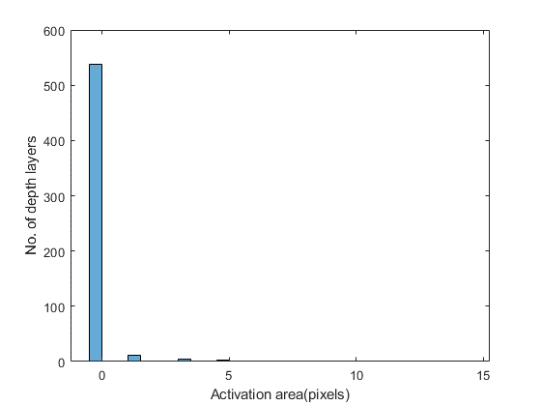

Slide 7
Conventional Wavefront Recording Plane (M-WRP)
T_p = 148.4114

Slide 8
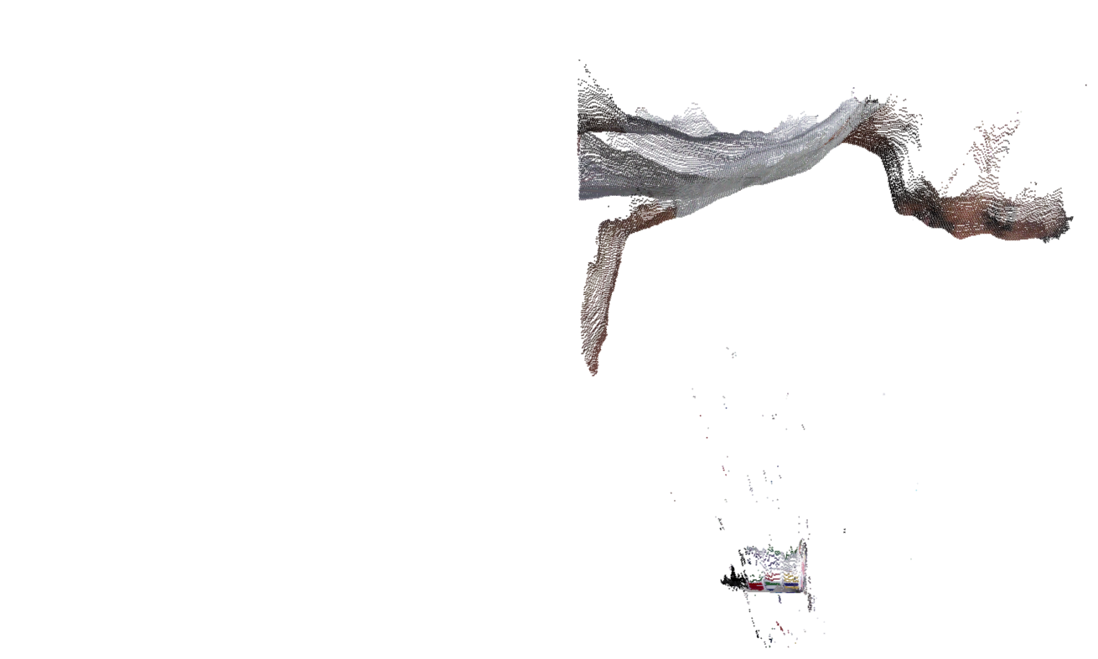
Distributed Multiple-WRP
-8
-4
-4
7
-8
0
-5
0
1
1
7
-2
34
26
22
18
25
17
17
12
12
13
14
21
19
4
0
11
-15
8
-5
5
1
0
6
-9
Second Oder of
difference
First Oder of
difference
Fig 5. Third order of difference

Slide 9
Distributed Multiple-WRP
-8
-4
-4
7
-8
0
-5
0
1
1
7
-2
34
26
22
18
25
17
17
12
12
13
14
21
19
4
0
11
-15
8
-5
5
1
0
6
-9
Second Oder of
difference
First Oder of
difference
Fig 6. Depth segmentation in DM-WRP

Slide 10
Distributed Multiple-WRP (DM-WRP)
Below all steps of DM-WRPs are presented:
Find number of object points in each depth layer, n
Find third order of differences and create depth ranges, C
Find depth range with maximum number of depth layers, C_{i}
If first order of difference for C_{i} is not zero, repeat step 2 for all values of C_{i} and update C

Slide 11
Distributed Multiple-WRP (DM-WRP)
No. of object point: 97,396
No. of depth layer : 165
[No. of object point in depth layer ^{i}, No. of object point in depth layer ^{i+1}, ]
[34;26] [22;18] [25;17] [17;12;12;13;14] [21;30] [13;4]
[9;5] [6;13] [22;61] [170;96] [102;215] [267;454]
[676;636] [542;476] [585;944] [1182;2238] [2030;1897] [1690;1709] [1534;1733] [1608;1698] [1675;1766] [1672;1778] [1711;1757] [1631;1748] [1570;1507] [1247;1273] [1165;1294] [1341;1165] [845;689] [614;653] [543;517] [410;356] [315;328] [269;209] [207;228] [134;85] [51;46] [48;13;8;3] [2;1] [2;2;2;2;2;2] [1;2;2;2;2] [1;2]
[1;4] [1;89] [434;373] [615;776] [818;742] [905;1044] [1152;1004] [1199;1878] [2542;2268] [2508;1932] [2413;2159] [2268;1837] [2521;2093] [2108;1765] [1392;725] [472;324] [276;179] [149;85] [93;100] [126;51] [3;1] [1;1;1;1;1] [4;5] [11;12] [19;22] [31;27] [39;30] [42;99] [149;216] [261;314] [307;225;179;137;56;7]
Fig 7. Depth ranges with number of depth layers and object points

Slide 12
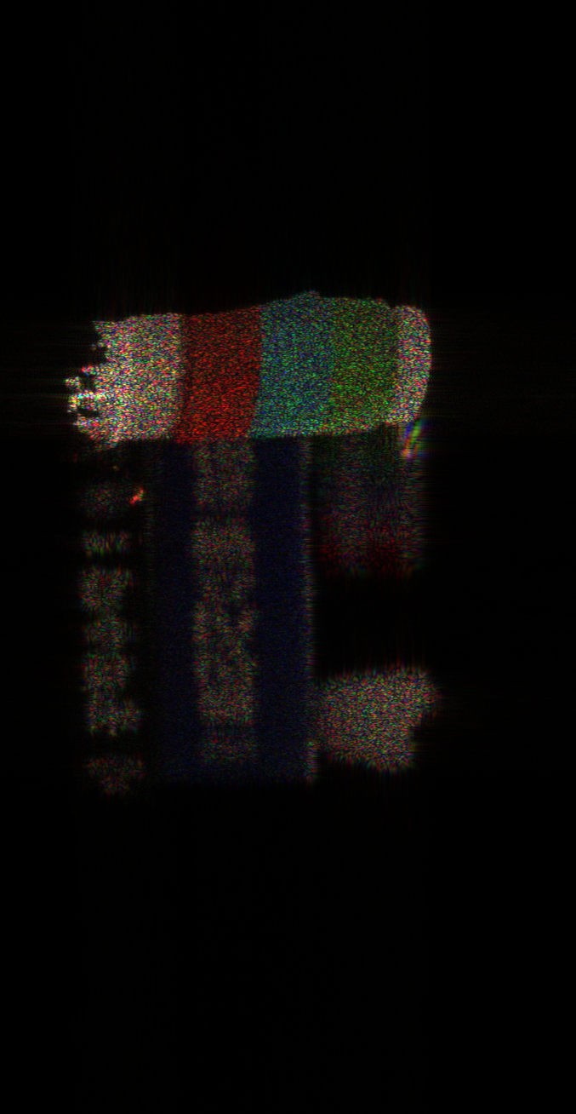
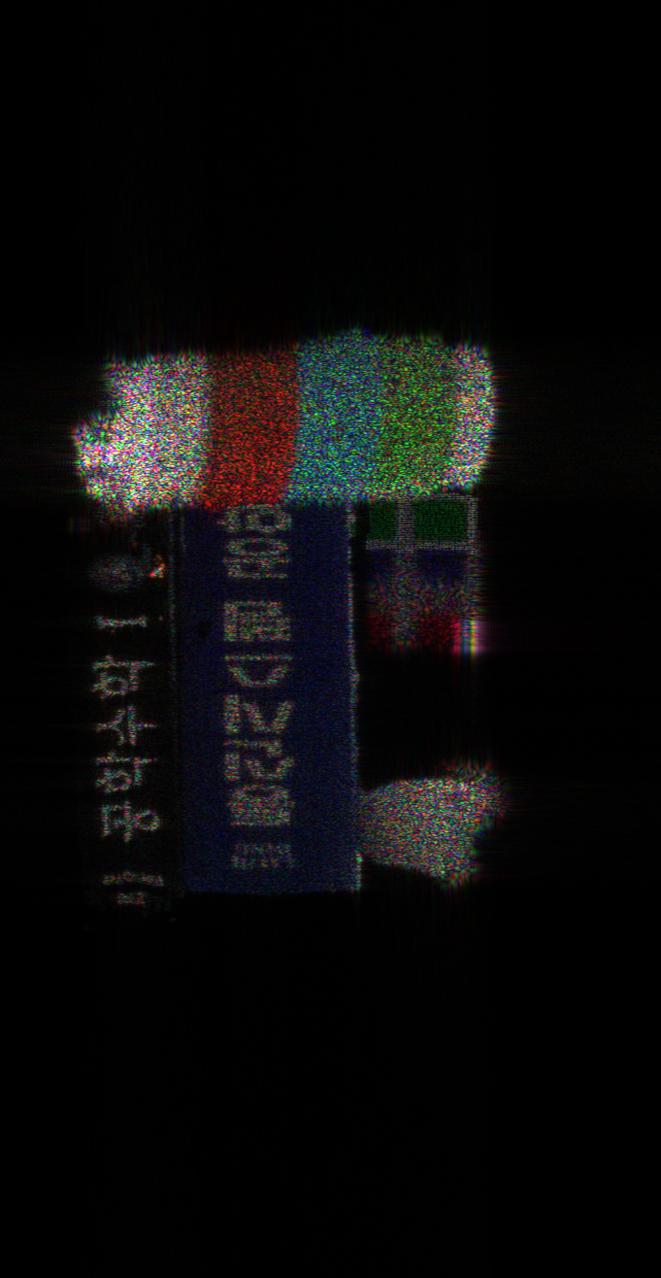
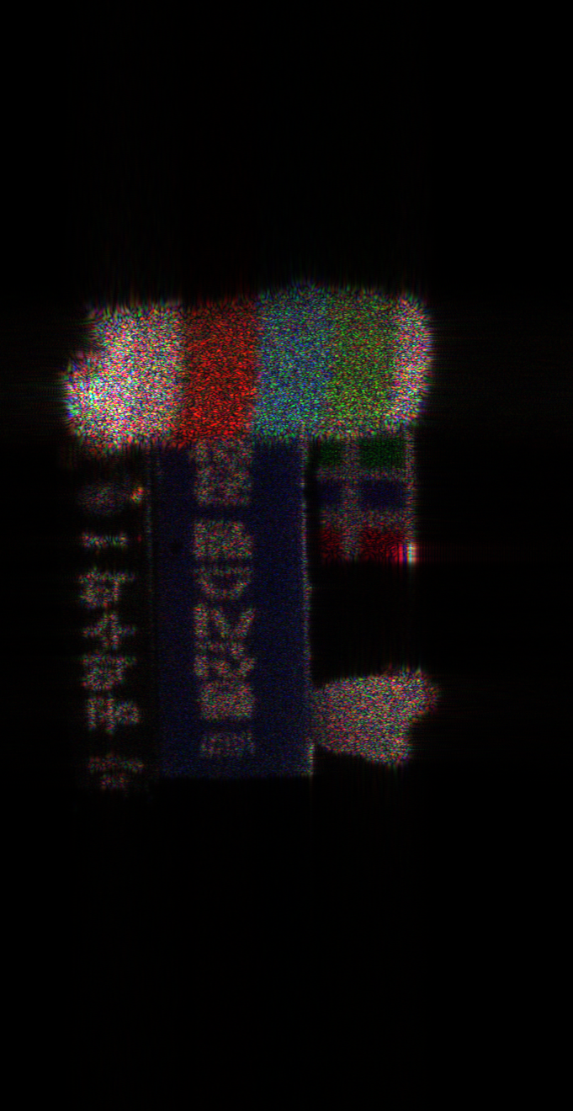

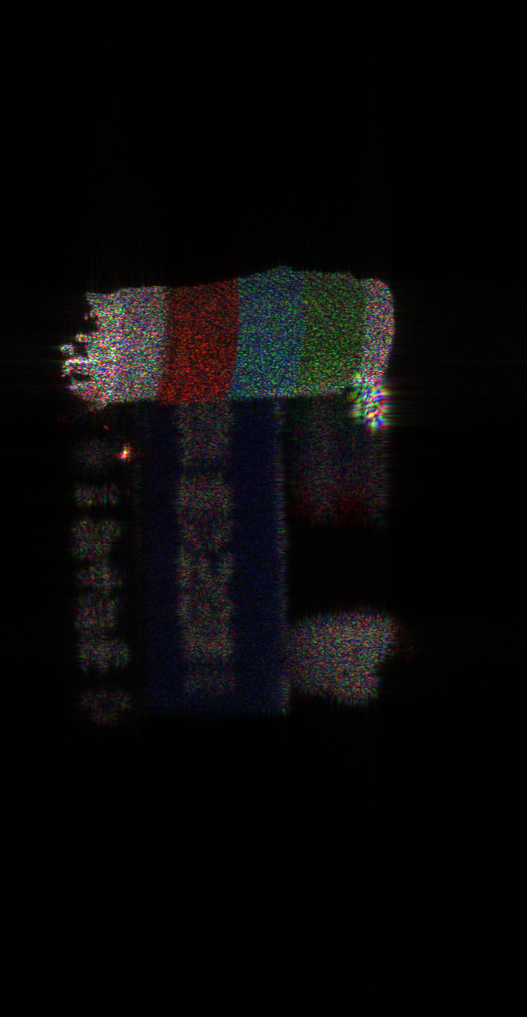
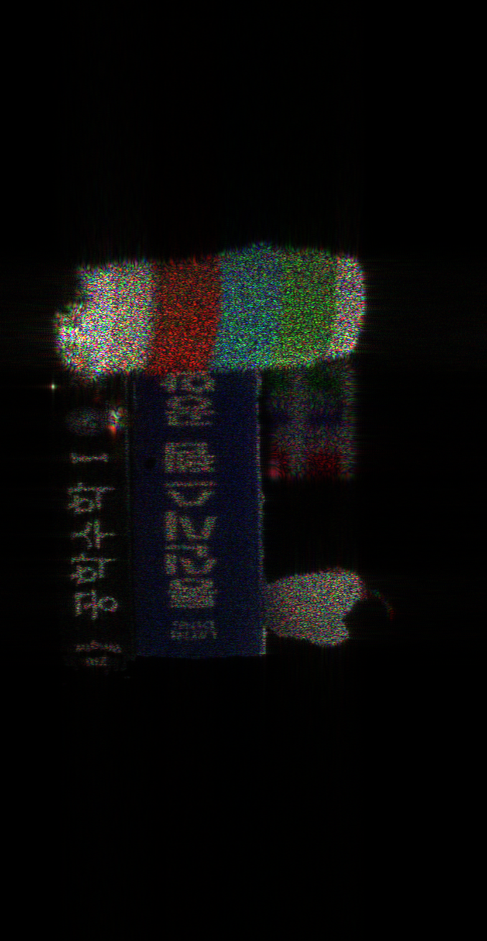
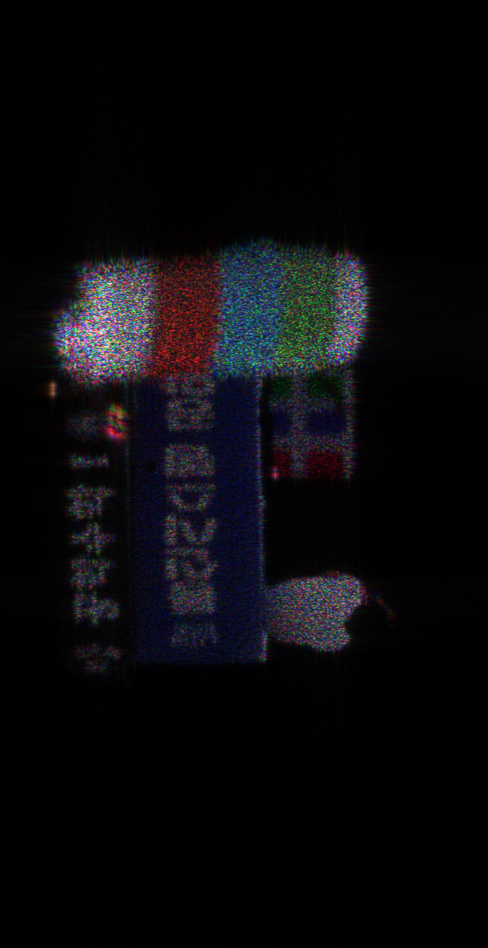
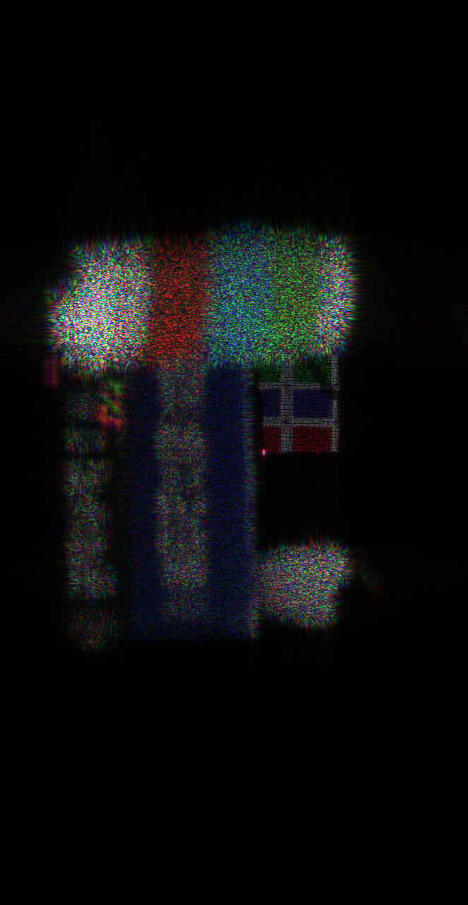
Distributed Multiple-WRP (DM-WRP)
Conventional
M-WRP
Proposed
DM-WRP
Focused on Cup
d = 0.488
Focused on Book
d = 0.480
Focused on Chicken
d = 0.4750
Focused on Cube
d = 0.467
Fig 8. Reconstructed image of four-items using Conventional M-WRP and DM-WRP methods

Slide 13
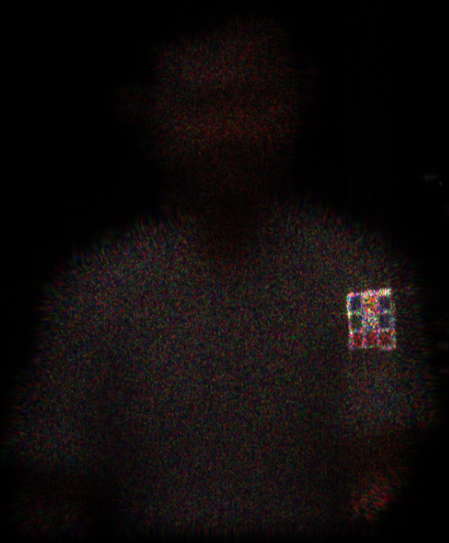
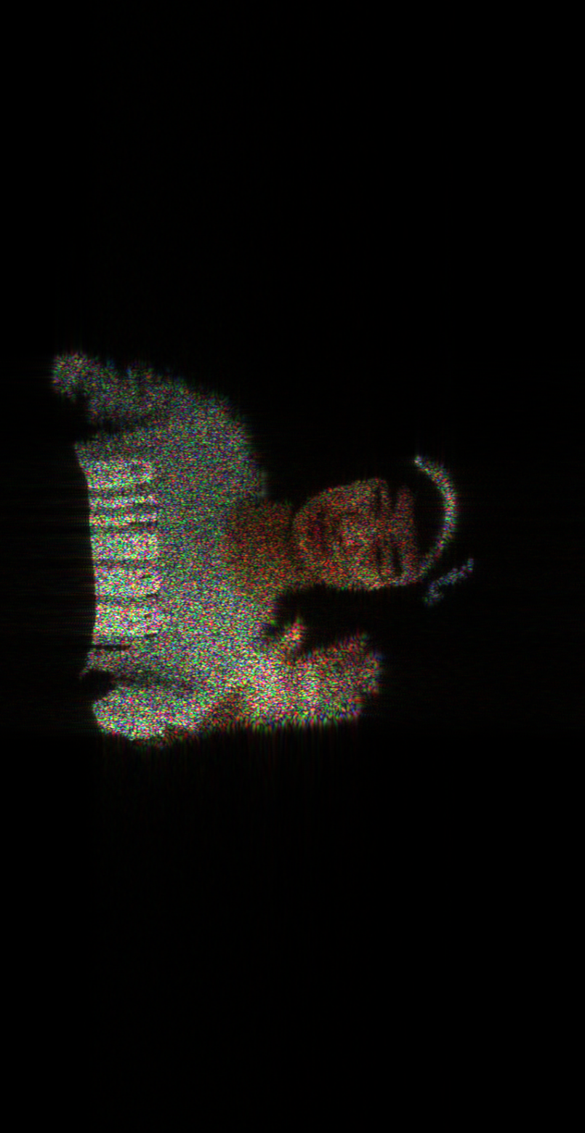
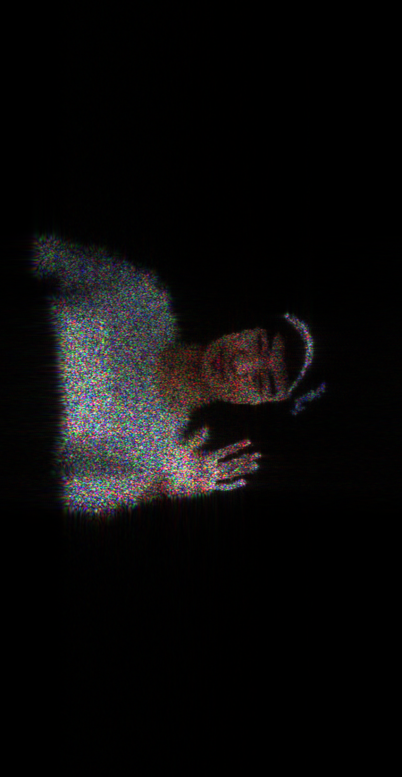
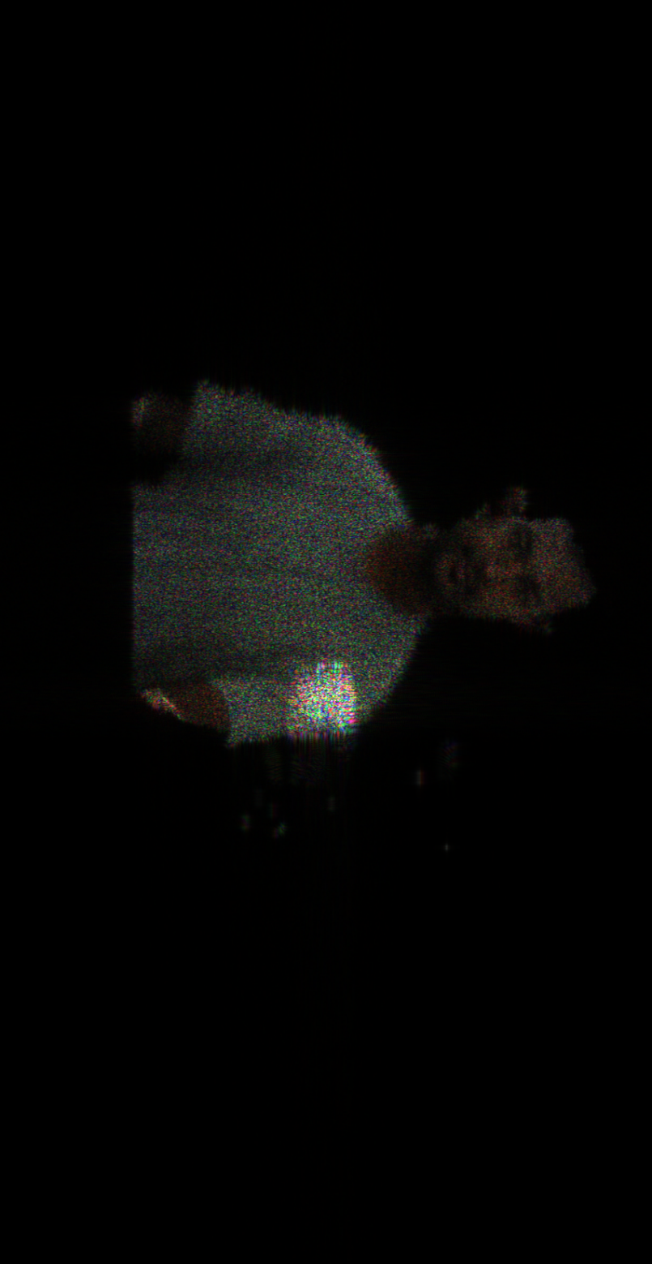
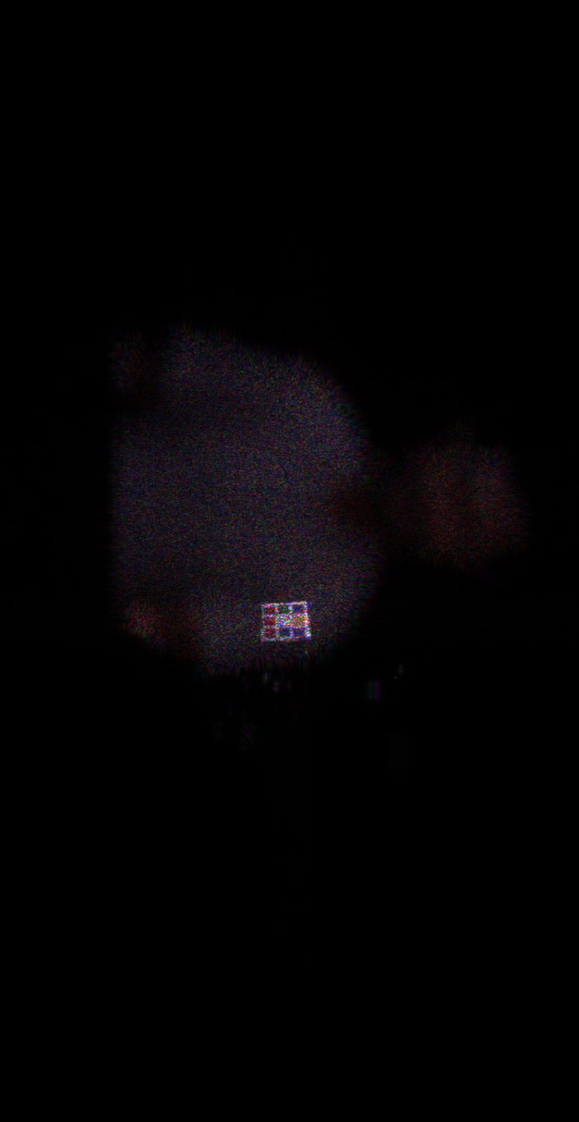
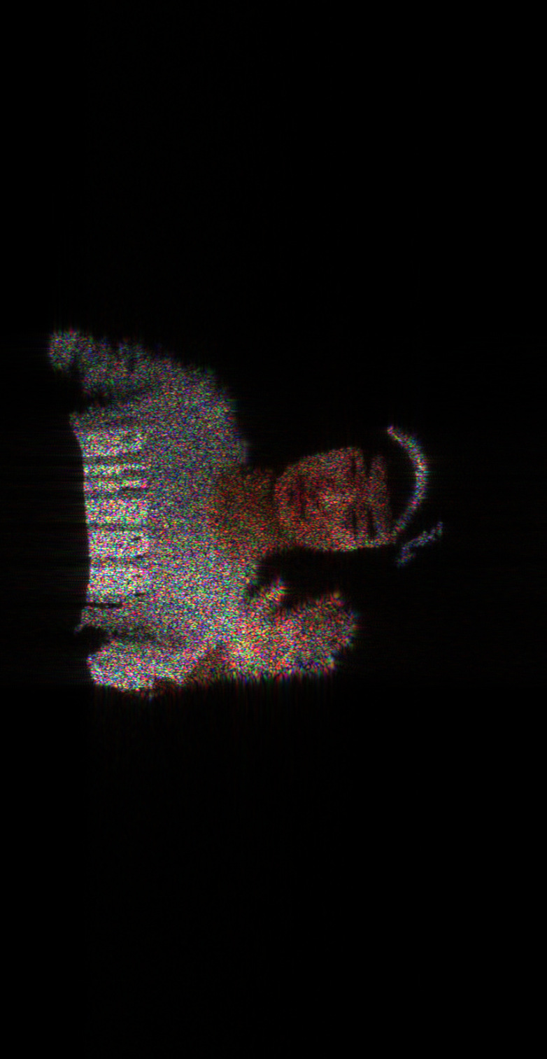
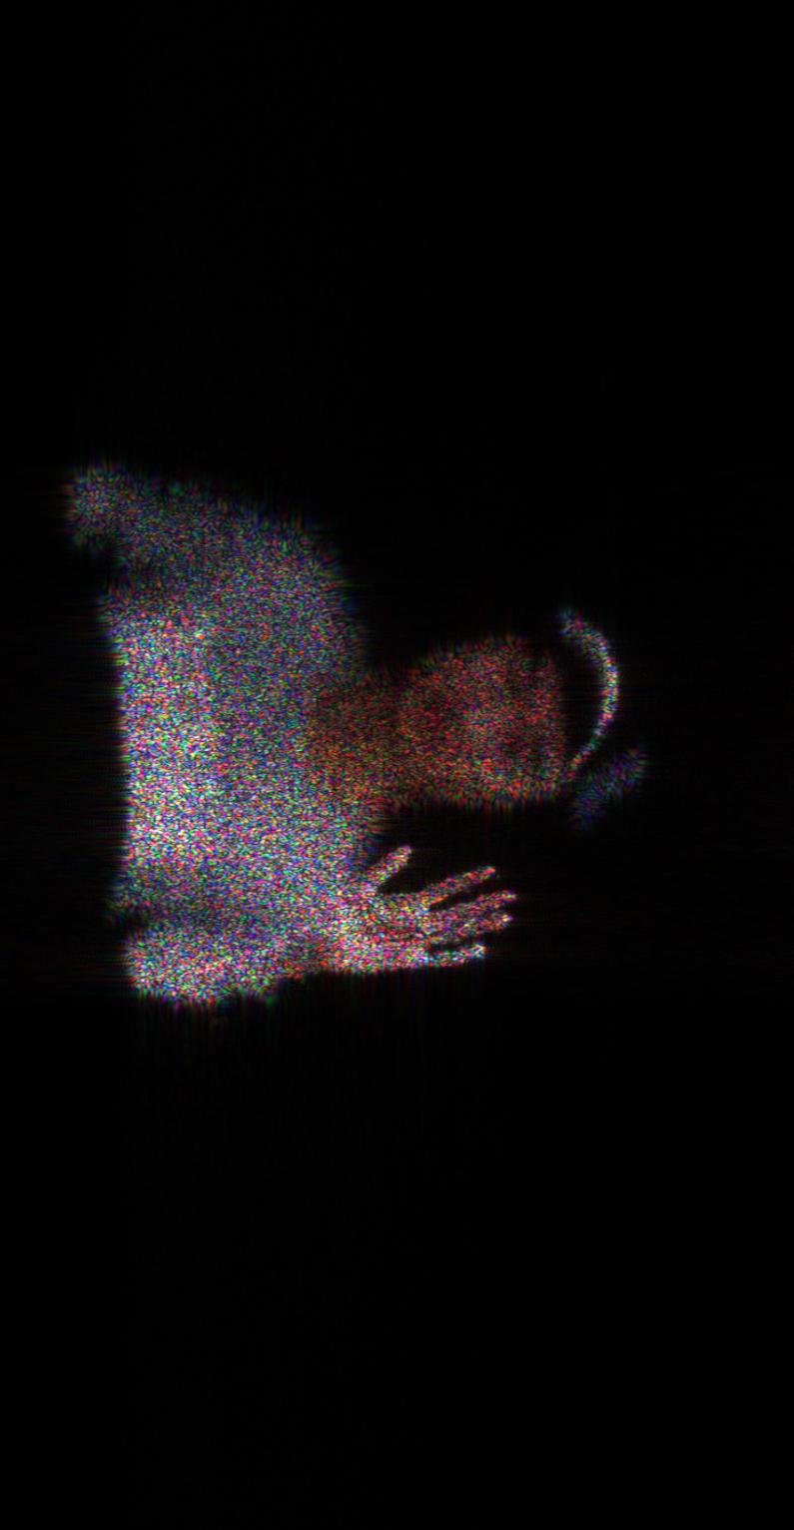
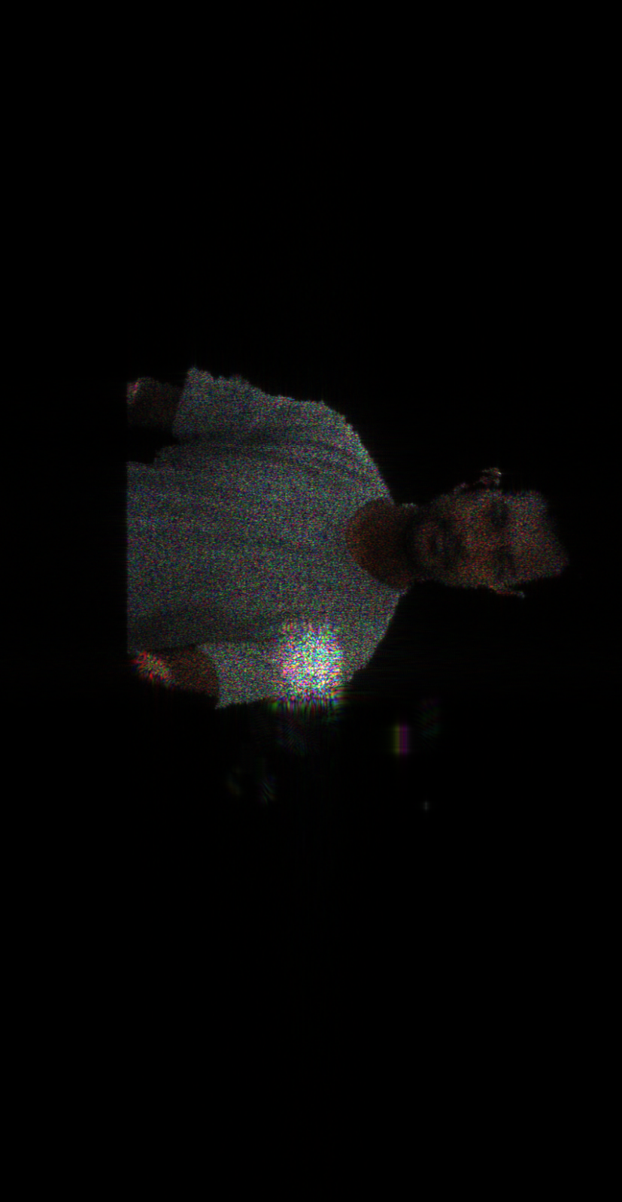
Convention
M-WRP
DM-WRP
person
d = 0.328
cube
d = 0.342
face
d = 0.462
hand
d = 0.471
Fig 9. Reconstructed image of Person1 and Person2 using Conventional M-WRP and DM-WRP methods

Slide 14
Results
Object | No. of object point | No. of depth layer | Conventional M-WRP |  |  | Proposed DM-WRP
 |  |  | No. of WRP | Time | PSNR | No. of WRP | Time | PSNR
Four_items | 97,396 | 165 | 83 | 449.2968 |  | 73 | 386.9348 13.8%
Person1 | 88,874 | 495 | 248 | 538.6747 |  | 215 | 487.9805 9.41%
Person2 | 119,077 | 297 | 149 | 714.9340 |  | 140 | 578.9152 19.02%
Table 1 : Time and PSNR comparison between conventional M-WRP and DM-WRP

Slide 15
